Slide 1
STOCK MARKET FORECASTING (Using Time Series Analysis)
Team Members:
Dipanshu Agarwal(N-201)
Riya Airen(N-204)
Saurabh Ajit(N-205)
Project Mentor(s):
Ms. Varsha Nemade

Slide 2
Index
Introduction
Goal
Schedule
Literature Review
Methodology
Algorithms
Technological Stack
Conclusion
References

Slide 3
Introduction
Stock Market prediction has always had a certain appeal for researchers. While numerous scientific attempts have been made, no method has been discovered to accurately predict stock price movement. The difficulty of prediction lies in the complexities of modelling market dynamics. Even with a lack of consistent prediction methods, there have been some mild successes. Stock Market research encapsulates two elemental trading philosophies; Fundamental and Technical approaches. In Fundamental analysis, Stock Market price movements are believed to derive from a security’s relative data. Fundamentalists use numeric information such as earnings, ratios, and management effectiveness to determine future forecasts. In Technical analysis, it is believed that market timing is key. Technicians utilize charts and modelling techniques to identify trends in price and volume. These later individuals rely on historical data in order to predict future outcomes.
The stock market appears in the news every day. Every time it reaches a new high or a new low. The rate of investment and business opportunities in the Stock market can increase if an efficient algorithm could be devised to predict the short term price of an individual stock.

Slide 4
Goal
In the past decades, there is an increasing interest in predicting markets among economists, policymakers, academics and market makers. The objective of the proposed work is to study and implement the supervised learning algorithm to predict the stock price.
TECHNICAL OBJECTIVE
The technical objectives will be implemented in Python. The system must be able to access a list of historical prices. It must calculate the estimated price of stock based on the historical data. It must also provide an instantaneous visualization of the market index.
To add to the academic understanding of stock market prediction
This project will focus exclusively on predicting the daily trend (price movement) of individual stocks
The project will also analyse the accuracies of these predictions
The project will also compare the accuracy percentage between the different models implemented.

Slide 5
Schedule
Study of Basics of Time-Series Analysis and Fundamentals of Trading
Collecting of Dataset and Data-set Pre-Processing & Normalization
Study of Different Time-Series Models and Selection of Models
Literature Review
Study of the Mathematical concepts behind the model
Creation of Model using python and various python libraries as well as studying the various functions used in the model
Training, Testing and Validation of the Model and Calculation of Error Values
Final Project Report and Submission

Slide 6
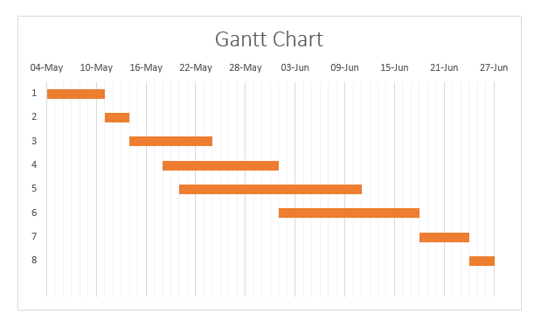
Schedule(cont.)
A time frame indicating steps that will be required and the expected date when they will be completed.

Slide 7
Literature Review
Contreras et al. [3] used ARIMA models to predict next day electricity prices; they have found two ARIMA models to predict hourly prices in the electricity markets of Spain and California. The Spanish model needs 5 hours to predict future prices as opposed to the 2 hours needed by the Californian model.
Kumar et al. [4] used ARIMA model to forecast daily maximum surface ozone concentrations in Brunei Darussalam. They have found that ARIMA (1,0,1) was suitable for the surface 03 data collected at the airport in Brunei Darussalam.
Tsitsika et al. [5] used ARIMA model to forecast pelagic fish production. The final model selected were of the form AR[MA (1,0,1) and AR[MA (0,1,1 ).
Azad et al. [6] used ARIMA model in forecasting Exchange Rates of Bangladesh. By using Box-Jenkins methodology they tried to find out the best model for forecasting.
Debadrita Banerjee et al.[7] has collected data on the monthly closing stock indices of sensex for six years(2007-2012) and based on these she has tried to develop an appropriate model which would help her to forecast the future unobserved values of the Indian stock market indices. This study offers an application of ARIMA model based on which she predicts the future stock indices which have a strong influence on the performance of the Indian economy. To establish the model she applied the validation technique with the observed data of sensex of 2013.

Slide 8
Literature Review(contd…)
Q. Xie S. et al.[8] adopted an ensemble model of LSTM networks in predicting stock market data and compares the results obtained to that of a multilayer LSTM network. The proposed model approches the ensemble learning process by dividing the test data into a number of smaller data sets using the Bagging algorithm. The smaller datasets are then trained on a number of LSTM networks. The Bagging algoritm is then used to obtain a prediction result from the multiple test results. Data from the Shanghai Composite Index and Shenzen Composite Index, among others, were used. Results of the study showed that the amsemble LSTM network model had an increased accuracy of 11.7%, a precission increase of 8.5%, and a recall rate increase of 10%. The ensemble LSTM network model had a greater predictive accuracy than the multilayer LSTM network.
Yao F. et al.[9] apply LSTM networks to predict the price movement of a short-term and test it by an experiment on some stocks randomly selected from CSI 300 constituent stocks. The experiment shows that the precision, recall rate and critical error of LSTM are all better than that of the random prediction. It indicates that LSTM can be used in the trend prediction of stock price.
Qian et al.[10] conducted a stationary analysis of the stock's time-series data and then used the LSTM neural network algorithm to predict stock data under different stationary conditions, and performed statistical analysis on multiple experimental data. In addition, an ARIMA algorithm was introduced to compare with the LSTM. A large number of experimental results show that the LSTM neural network prediction algorithm has higher prediction accuracy and is not sensitive to the stability response.

Slide 9
Literature Review(contd…)
S.Kamath et al.[11] made use of Hadoop and ML. The big data technique by performing sentiment analysis of tweets and twitter and finding the correlation. Also, machine learning techniques are applied on the data of companies to predict the stock price of next day. Python code is used to perform the task and text editor used is Pycharm. Map-reduce technique is used to combine individual sentiment results and find a sentiment for each day. The big data technique is used to handle the large amount of data. All the four model, KNN, Random forest, neural network, and linear regression are used to predict the value of daily exchange. The predicted values showed that name of the four models were able to predict the values accurately. However the closest values were predicted by linear regression. The conclusion of their project was that the stock value change does not depend on the stock exchange index. It is dependent on the sentiments of social media
P.Domingos et al.[12] made use of linear regression. The aim of the research study is to help the stock broken and investors for investing money in the stock market. Python 2.7version is used for implementing linear, polynomial and RBF. The python scientific computing library numpy was used along with the data analysis library pandas in order to convert these CSV files into panda data frames. The stock price was predicted based on linear regression, polynomial and RBF regression using five variable. The linear regression gives the best result compare to another method stock exchange index. It is dependent on the sentiments of social media.

Slide 10
Time Series Analysis
Time series is simply a series of data points ordered in time. In a time series, time is often the independent variable and the goal is usually to make a forecast for the future.
The Time-Series generated may have any of the 3 properties:-
Auto-Correlation
Seasonality
Stationarity
Often Stock Prices are not a stationary process, since we might see a growing trend, or its volatility might increase over time i.e. variance is ever-changing.

Slide 11
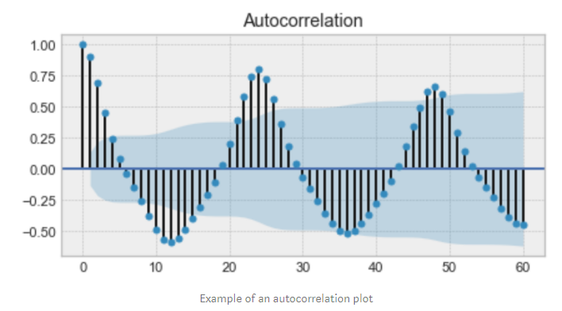
Auto-Correlation
Auto-Correlation: - is the similarity between observations as a function of the time lag between them. For example, in the graph below the first and the 24th value have a high autocorrelation similarly for the 12th and 36th value.
Figure : EXAMPLE OF AN AUTO-CORRELATION PLOT

Slide 12
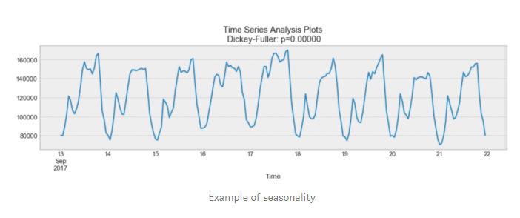
Seasonality
Seasonality: - Refers to periodic functions, for example electricity consumption is high during the day and low during night, or online sales increase during Christmas before slowing down again. Seasonality can also be derived from an Auto-Correlation Plot if it has a sinusoidal shape.
Figure : EXAMPLE OF SEASONALITY

Slide 13
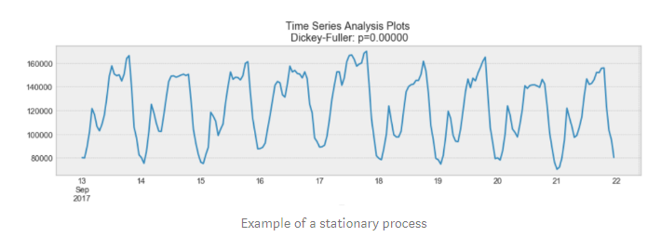
Stationarity
Stationarity: - is an important characteristic of time-series. A time-series is said to be stationary if its statistical properties do not change over time. In other words, it has constant mean and variance, and co-variance is independent of time.
Figure: EXAMPLE OF SEASONALITY

Slide 14
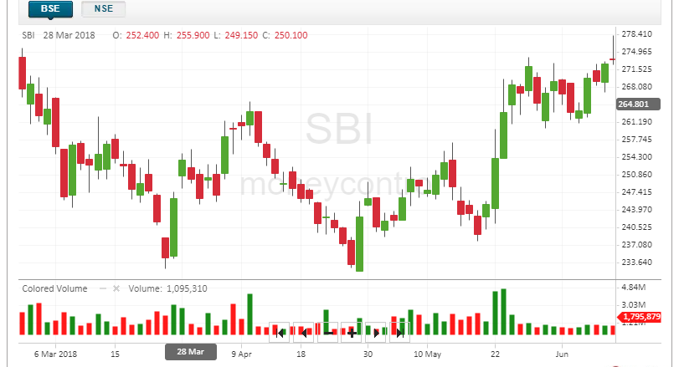
Fundamentals of Trading
Figure : A SAMPLE OF HOW THE TECHNICAL CHART IN BSE LOOKS LIKE
In the above graph, we see a peculiar representation technique being used which is known as a candlestick, a candlestick is a type of price chart used in technical analysis that displays the high, low, open, and closing prices of a security for a specific period.

Slide 15
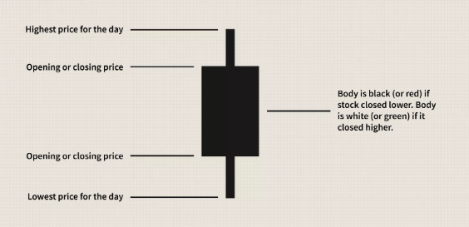
Fundamentals of Trading
Figure : TECHNICALITITES OF A CANDLESTICK FIGURE

Slide 16
Fundamentals of Trading
The main factors which bring about a huge change in the variance and mean of the security prices are:-
Buyer and Seller
IPO: - stand for Initial Public Offering. When the news media report that a company is "going public," this means that company is making an initial public offering. This means that the company is offering its shares for sale to the public for the first time.
Pandemics
Merger and Acquisitions: - Mergers and acquisitions are transactions in which the ownership of companies, other business organizations, or their operating units are transferred or consolidated with other entities.
Import and Export
Government Issues/Changes to Laws.

Slide 17

MAPE Value
The mean absolute percentage error (MAPE) is the mean or average of the absolute percentage errors of forecasts. Error is defined as actual or observed value minus the forecasted value. Percentage errors are summed without regard to sign to compute MAPE. This measure is easy to understand because it provides the error in terms of percentages. Also, because absolute percentage errors are used, the problem of positive and negative errors cancelling each other out is avoided. Consequently, MAPE has managerial appeal and is a measure commonly used in forecasting. The smaller the MAPE the better the forecast.
The mean absolute percentage error (MAPE) can be calculated as the average absolute percent error for each time period minus actual values divided by actual values. Where At is the actual value and Ft is the forecast value, this is given by:

Slide 18
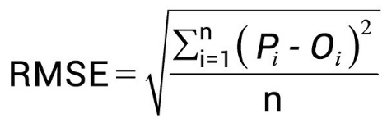
RMSE Value
The root-mean-square deviation (RMSD) or root-mean-square error (RMSE) is a frequently used measure of the differences between values (sample or population values) predicted by a model or an estimator and the values observed. The RMSD represents the square root of the second sample moment of the differences between predicted values and observed values of these differences. These deviations are called residuals when the calculations are performed over the data sample that was used for estimation and are called errors (or prediction errors) when computed out-of-sample. The RMSD serves to aggregate the magnitudes of the errors in predictions for various times into a single measure of predictive power. RMSD is a measure of accuracy.

Slide 19
Methodology
START
ORIGINAL DATASET
MODEL TESTING
MODEL IDENTIFICATION
ERROR CALCULATION
MODEL VISUALIZATION
MODEL BUILDING
REPEAT WITH OTHER MODEL
MODELTRAINING
END
Figure: FLOWCHART DEFINING THE APPROACH OF OUR PROJECT

Slide 20
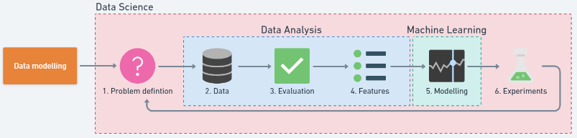
Methodology
FIGURE : - STEPS IN A FULL MACHINE LEARNING PROJECT [1]

Slide 21
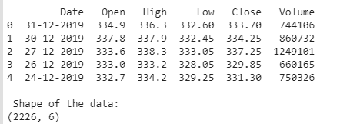
Understanding Dataset
We’ll be using a dataset from https://www.moneycontrol.com (you can find historical data for various stocks here) and for this particular project, we have used the data for ‘STATE BANK OF INDIA’. We have collected data from January 2011 to December 2019.
Figure : SNIPPING OF DATASET

Slide 22
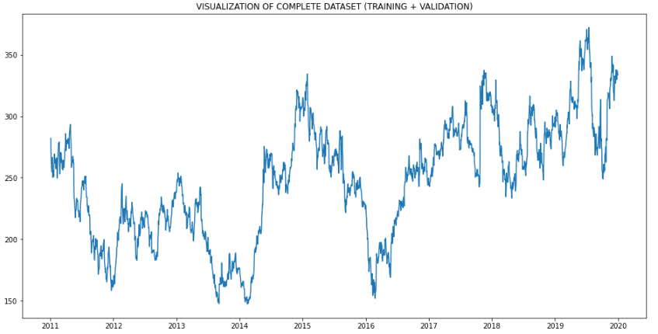
Understanding Dataset

Slide 23
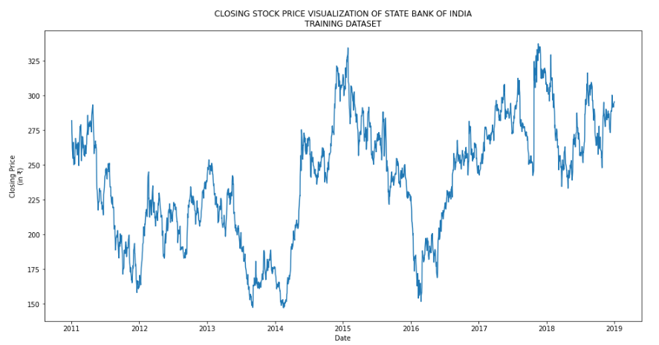
Training Part of Dataset

Slide 24
Modelling Time series
There are many ways to model a time series in order to make predictions:
Moving Average
Linear Regression
k-Nearest Neighbors
Prophet
Auto ARIMA
Long Short Term Memory (LSTM)

Slide 25
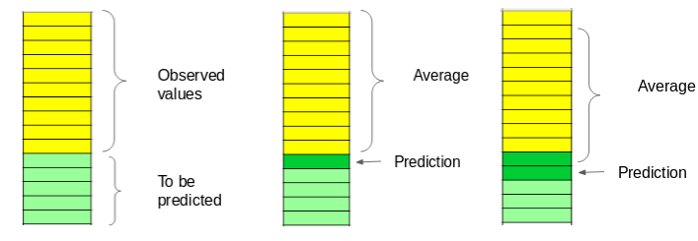
Moving Average
The moving average model is probably the most naive approach to time series modelling. This model simply states that the next observation is the mean of all past observations. We can define a window to apply the moving average model to smooth the time series, and highlight different trends.
Figure : PICTORIAL DEPICTION OF HOW MOVING AVERAGE LOOKS LIKE

Slide 26
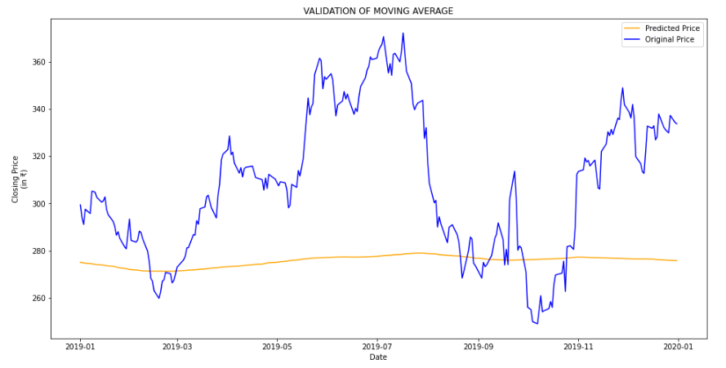
mape value - 44.46
rmse value – 33.33

Slide 27
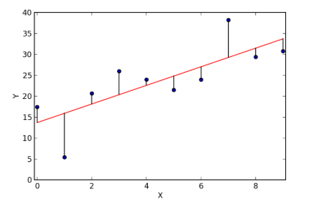
Linear Regression
The most basic machine learning algorithm that can be implemented on this data is linear regression. The linear regression model returns an equation that determines the relationship between the independent variables and the dependent variable.
EXAMPLE OF A LINEAR REGRESSION

Slide 28
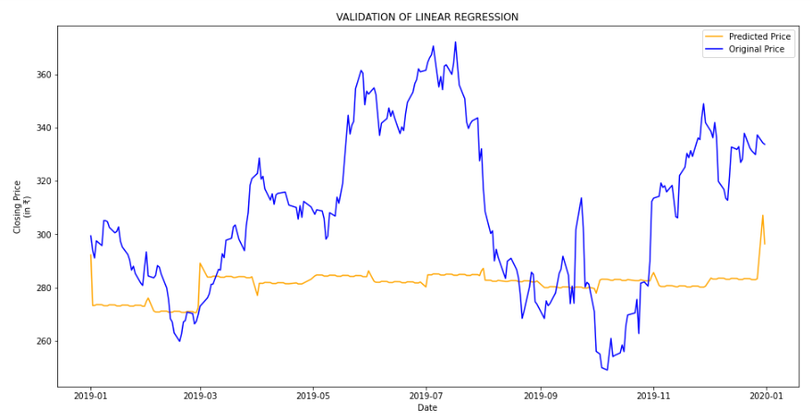
mape value – 25.72
rmse value – 38.43

Slide 29
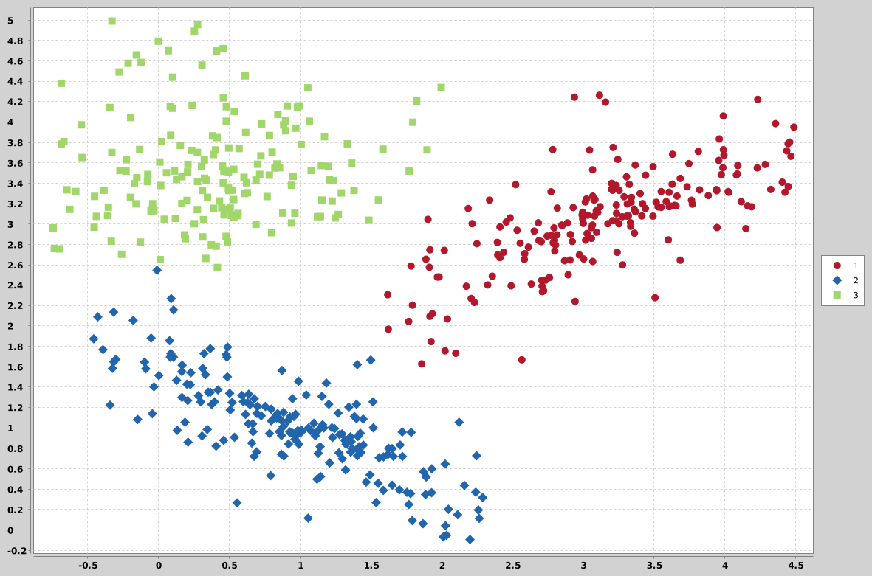
K-Nearest Neighbours
Another interesting ML algorithm that one can use here is kNN (k nearest Neighbours). Based on the independent variables, kNN finds the similarity between new data points and old data points.
EXAMPLE OF K-Nearest Neighbors

Slide 30
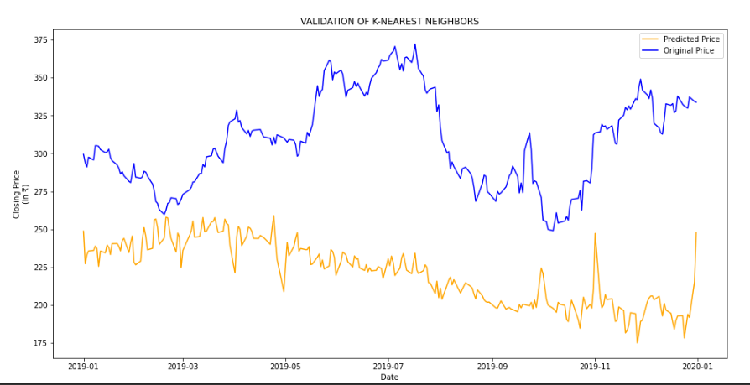
mape value – 87.08
rmse value – 94.68

Slide 31
Prophet
There are a number of time series techniques that can be implemented on the stock prediction dataset, but most of these techniques require a lot of data preprocessing before fitting the model. Prophet, designed and pioneered by Facebook, is a time series forecasting library that requires no data preprocessing and is extremely simple to implement. The input for Prophet is a dataframe with two columns: date and target (ds and y).
Prophet tries to capture the seasonality in the past data and works well when the dataset is large.

Slide 32
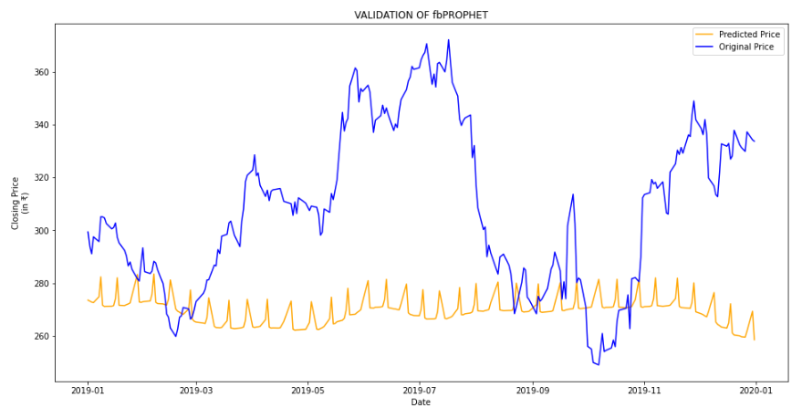
mape value – 39.03
rmse value – 50.32

Slide 33
Auto-Arima
ARIMA is a very popular statistical method for time series forecasting. ARIMA models take into account the past values to predict the future values. There are three important parameters in ARIMA:
p (past values used for forecasting the next value)
q (past forecast errors used to predict the future values)
d (order of differencing)
Parameter tuning for ARIMA consumes a lot of time. So we will use auto ARIMA which automatically selects the best combination of (p,q,d) that provides the least error.

Slide 34
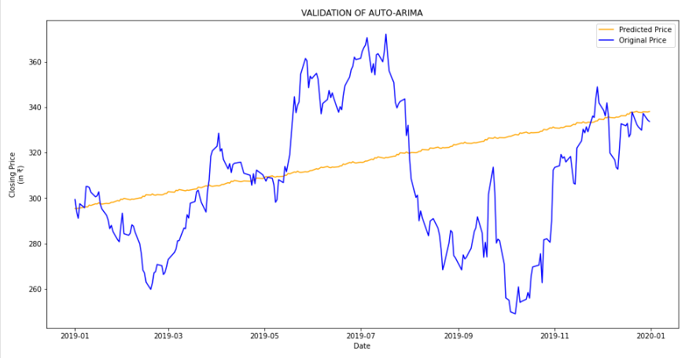
mape value – 7.35
rmse value – 31.84

Slide 35
LSTM
Long Short Term Memory (LSTM) are widely used for sequence prediction problems and have proven to be extremely effective. The reason they work so well is because LSTM is able to store past information that is important, and forget the information that is not.
LSTM has three gates:
The input gate: The input gate adds information to the cell state
The forget gate: It removes the information that is no longer required by the model
The output gate: Output Gate at LSTM selects the information to be shown as output

Slide 36
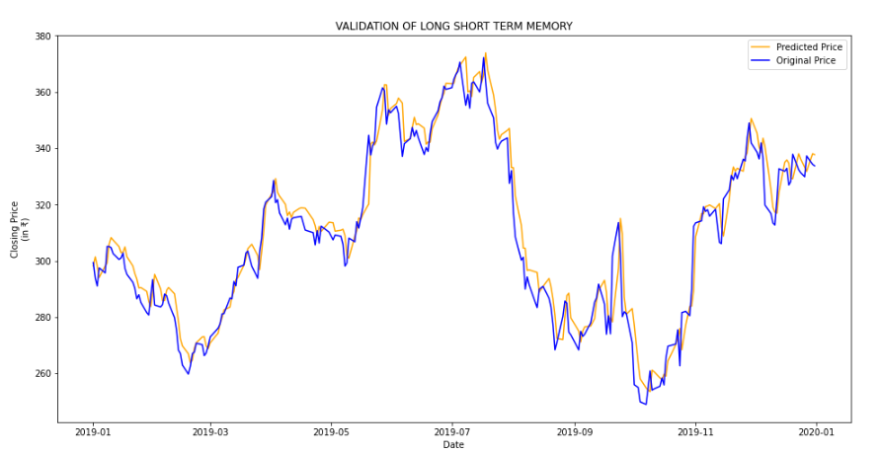
mape value - 1.09
rmse value – 7.35

Slide 37
Conclusion
For comparison of all the models till now we will plot the values of RMSE and MAPE obtained for each of the model. Then we will derive further conclusions based on the values, such as the optimal model out of all the implanted ones, which of the models are same as to that of their predicting natures and such on.
Table 1: COMPARITIVE STUDY OF RMSE & MAPE VALUES (ODER BY EFFICIENCY)
MODEL NAME | RMSE VALUE | MAPE VALUE
Long Short Term Memory | 7.35 | 1.09
Auto Arima | 31.84 | 7.35
Linear Regression | 38.43 | 25.72
Moving Average | 33.33 | 44.46
fbProphet | 50.32 | 39.03
K-Nearest Neighbors | 94.68 | 87.08

Slide 38
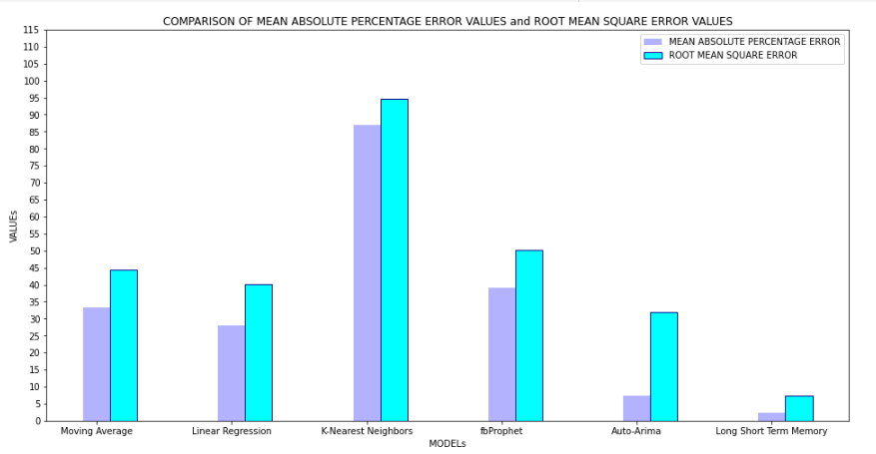
COMPARISON OF MAPE and RMSE
Figure: COMPARISON OF MAPE and RMSE VALUES

Slide 39
Inferences
As we can see in Table 1 and Figure 36, LSTM is the most efficient model which was implemented on our particular dataset, because as LSTM is an R-NN model, which is able to selectively work on the past data i.e. only on the needed values which may effect on the trend and seasonality, thus showing a much more effective outcome and very less loss in the predictions.
The second best model implemented was the Auto-Arima model, the Arima model was able to effectively capture the trend which was present in our dataset, but it could not work with the seasonality in order to minimize the loss. We can still improve the efficiency of the arima model if we were to hyper-tune its p, d, and q variables, but even then it may not perform upto the standards of the LSTM model on an equal no of hyper-tuned parameters.

Slide 40
Inferences
The KNN and Linear Regression models did not work well with our particular time-series dataset, since we were only focused on the variables, DATE and CLOSE, and we were predicting the CLOSE so it had only DATE as a viable option for feature extraction, and we all know that from a DATE, one can only study it TIME, DAY, MONTH, WEEK and YEAR. There are not a lot of different features which can be worked upon thus, they fail to even predict the trend much less the seasonality.
The Prophet model which was specifically designed the Facebook, to work with TIME-SERIES, has failed in our case because, a Stock Market Dataset may be a Time-Series Dataset, but at the end of the day, it does not follows as strict trend or seasonality, as the other Time-Series, because there are other factors also present in the real-world which may bring about a drastic change in Stock Prices.

Slide 41
END NOTE
The LSTM model was the best model implemented out of all to work with Time-Series. But are the predictions from LSTM enough to identify whether the stock price will increase or decrease? Certainly not!
As we know, stock price is affected by the news about the company and other factors like demonetization or merger/demerger of the companies. There are certain intangible factors as well which can often be impossible to predict beforehand.
Time series forecasting is a very intriguing field to work with, as we have realized during the time spent on this project. There is a perception in the community that it’s a complex field, and while there is a grain of truth in there, it’s not so difficult once you get the hang of the basic techniques.

Slide 42
References
A 6 Step Field Guide for Building Machine Learning Projects by Daniel Bourke
Introduction to Time Series Forecasting With Python by Jason Brownlee
Contreras, 1. Espinola, R.NogaJes, F1.and conejo,AJ.(2003) "ARIMA models to predict next day electricity prices", IFEE transactions on power system, vo1.18, noJ,pp: I 014-1 020.
Kumar; K Yadav;A.KSingh, M.P; Hassan and H.Jain,V.K(2004)"Forecasting Daily Maximum Surface Ozone".
Tsitsika,E.V;Maravelias,C.D& Haralatous,J. (2007)"Modelling and forecasting pelagic fish production using univariate and multivariate ARIMA models". Fisheries science volume 73,pp:979-988.
Datta K.(2011)"ARIMA forecasting of Inflation in the Bangladesh Economy",The IUP journal of bank management,voI.X,No.4,pp-7-15.
D. Banerjee, "Forecasting of Indian stock market using time-series ARIMA model," 2014 2nd International Conference on Business and Information Management (ICBIM), Durgapur, 2014, pp. 131-135, doi: 10.1109/ICBIM.2014.6970973.
Q. Xie, G. Cheng, X. Xu, and Z. Zhao, “Research based on stock predicting model of neural networks ensemble learning,” in MATEC Web of Conferences, vol. 232. EDP Sciences, 2018, p. 02029. S. Yao, L. Luo and H. Peng, "High-Frequency Stock Trend Forecast Using LSTM Model," 2018 13th International Conference on Computer Science & Education (ICCSE), Colombo, 2018, pp. 1-4, doi: 10.1109/ICCSE.2018.8468703.
F. Qian and X. Chen, "Stock Prediction Based on LSTM under Different Stability," 2019 IEEE 4th International Conference on Cloud Computing and Big Data Analysis (ICCCBDA), Chengdu, China, 2019, pp. 483-486, doi: 10.1109/ICCCBDA.2019.8725709.
S.Kamath, “Stock Market Analysis”, Master’s Projects, pp. 326, 2012
P.Domingos, “A Few Useful Things to Know about Machine Learning,”Communications of the ACM, Vol. 55 No. 10, October 2012.
“Introduction to Time Series Analysis and Forecasting” by Douglas C. Montgomery, Cheryl L. Jennings, and Murat Kulahci
“Time Series Analysis: Forecasting and Control” by George E. P. Box, Gwilym M. Jenkins, Gregory C. Reinsel, and Greta M. Ljung
Chris Chatfield, "The analysis of time series An introduction"

Slide 43
Thank you

